Slide 1

Project Title :Seasonal Agriculture Performance Analysis
STUDENT NAME: JUKANTI RAMCHARAN
COLLEGE NAME: VAAGDEVI COLLEGE OF ENGINEERING
AICTE STU ID : STU6a3009b7a197d1781533111

Slide 2

PROBLEM STATEMENT
Agricultural activities are influenced by seasonal variations in environmental conditions, farming practices, resource availability and market conditions
As a result, agricultural performance may differ from one season to another
However, raw agricultural data does not clearly explain how agricultural performance changes across seasons or what patterns can be observed in different seasonal conditions
The problem is to analyze the given agricultural dataset and investigate seasonal differences in agricultural performance by identifying meaningful patterns, trends, relationships and variations within the available data

Slide 3
PROJECT DESCRIPTION
The project “Seasonal Agriculture Performance Analysis” focuses on analyzing agricultural data collected across different seasons, geographical areas, and farming conditions. The dataset contains information about farming practices, environmental conditions, crop production, resource usage, and economic performance

Slide 4

WHO ARE THE END USERS?
Farmers – To understand seasonal agricultural performance and improve planning
Agricultural planners – To support evidence-based seasonal planning
Agricultural organizations– To compare seasonal performance and resource usage
Researchers and data analysts – To study agricultural patterns, trends, and relationships
Students/educational institutions – To learn and demonstrate real-world data analytics

Slide 5

Technology Used
Python
Google Colab
Pandas – Data handling and cleaning
NumPy – Numerical operations
Matplotlib / Seaborn – Data Visualization
Statistical analysis – Understanding patterns and relationships

Slide 6
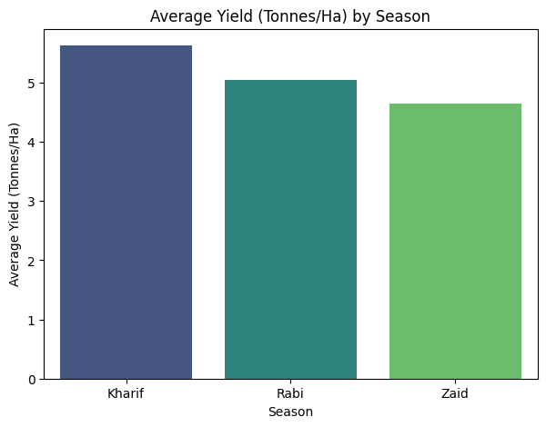
RESULTS
This bar graph represents the average agricultural yield across three seasons:
Kharif, Rabi, and Zaid
Kharif has the highest average yield of around 5.6 tonnes per hectare, followed by Rabi at around 5.0 tonnes per hectare
Zaid has the lowest average yield at around 4.6 tonnes per hectare
From this graph, we can conclude that agricultural yield differs across seasons, with Kharif showing the highest average performance

Slide 7
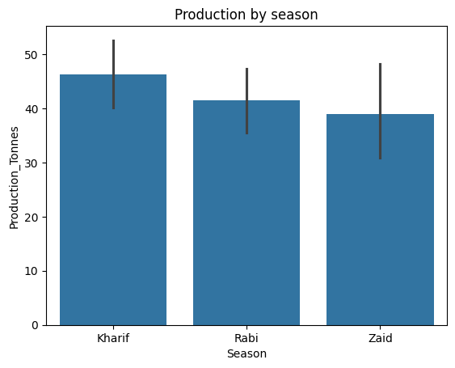
RESULTS
This graph represents production across three agricultural seasons
Kharif has the highest average production of about 46 tonnes, followed by Rabi with about 41.5 tonnes. Zaid has the lowest production at about 39 tonnes
Therefore, Kharif shows the highest production, while Zaid shows the lowest. The error bars indicate the variation in production values

Slide 8
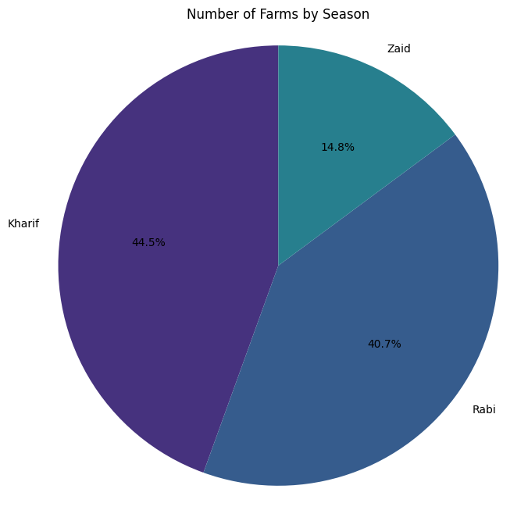
RESULTS
This pie chart represents the distribution of farms across different seasons
Kharif accounts for 44.5% of the farms, Rabi accounts for 40.7%, and Zaid accounts for 14.8%
Therefore, Kharif has the largest share of farms, while Zaid has the smallest share.

Slide 9
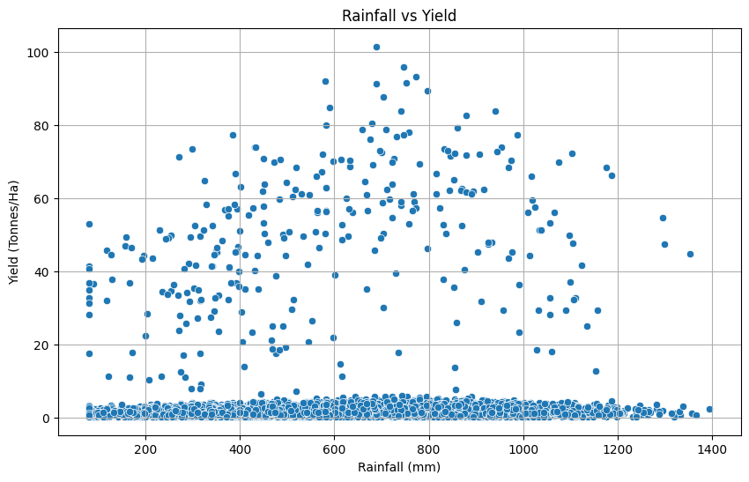
RESULTS
This scatter plot represents the relationship between rainfall and agricultural yield. Rainfall is shown on the X-axis and yield is shown on the Y-axis
Each dot represents an observation. We can see that the data points are widely distributed, meaning rainfall alone does not determine yield
Some higher yields occur at moderate to high rainfall levels, but there is considerable variation. Therefore, other factors such as farming practices, soil conditions, resources, and environmental conditions may also affect agricultural yield

Slide 10
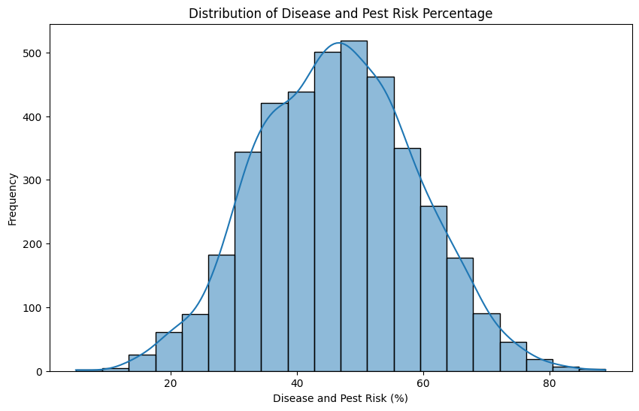
RESULTS
This histogram represents the distribution of disease and pest risk percentages
The X-axis shows the risk percentage, while the Y-axis shows the frequency of observations
Most of the observations are concentrated between 30% and 65%, with the highest frequency around 45% to 50%. Very low and very high risk values occur less frequently
Overall, the distribution is approximately bell-shaped, showing that moderate disease and pest risk is most common in the dataset

Slide 11
Future scope
The future scope of this project is to extend the analysis using real-time data
We can predict crop yield, disease and pest risk, analyze different regions, optimize resource usage, and develop an interactive dashboard
These improvements can help farmers and agricultural stakeholders make better data-driven decisions for seasonal planning

Slide 12
GitHub Link
https://github.com/ramcharan09-bit/Seasonal-Agriculture-Performance-Analysis

Slide 13

VOIS Course completion certificate - Course name- Data Visualization

Slide 14
Thank you
.
.

